Slide 1
MS PowerPoint Application
Rekha
ER/CORP/

Slide 2
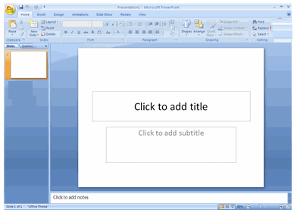
Overview of PowerPoint
A presentation is a collection of data and information that is to be delivered to a specific audience.
A PowerPoint presentation is a collection of slides that can have text, pictures, graphics, tables, sound , video, animation & Transition.
This collection can run automatically or can be controlled by a presenter.
Notes:
Title bar
Status bar
Slide Pane: Displays a slide one at a time
Short cut of slide views: Includes Normal View, Slide Sorter and Slide Show
Notes Pane: Can be used for adding notes to the presentation

Slide 3
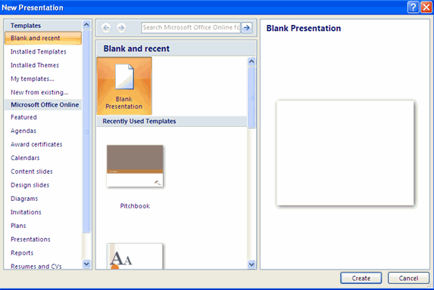
Creating a new slide
Notes:
Click on the Microsoft Office Button
Click on New
Click on Blank Presentation
Click on Create

Slide 4
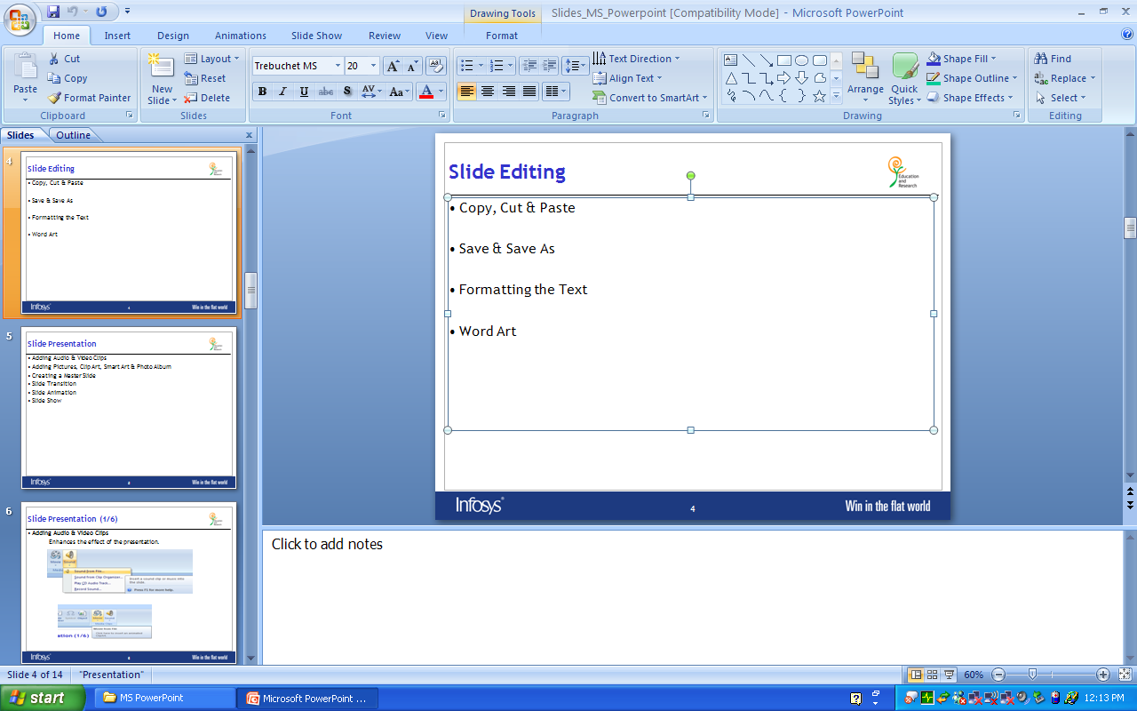
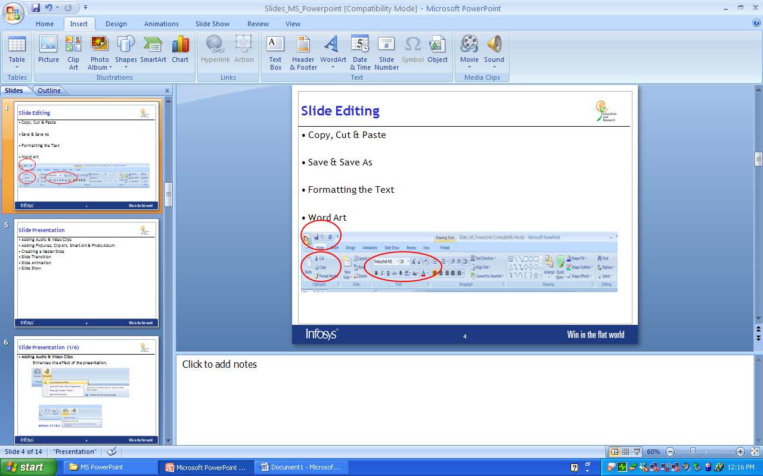
Slide Editing
Copy, Cut & Paste
Save & Save As
Formatting the Text
Word Art

Slide 5
Slide Presentation
Adding Audio & Video Clips
Adding Pictures, Clip Art, Smart Art & Photo Album
Creating a Master Slide
Slide Transition
Slide Animation
Slide Show

Slide 6
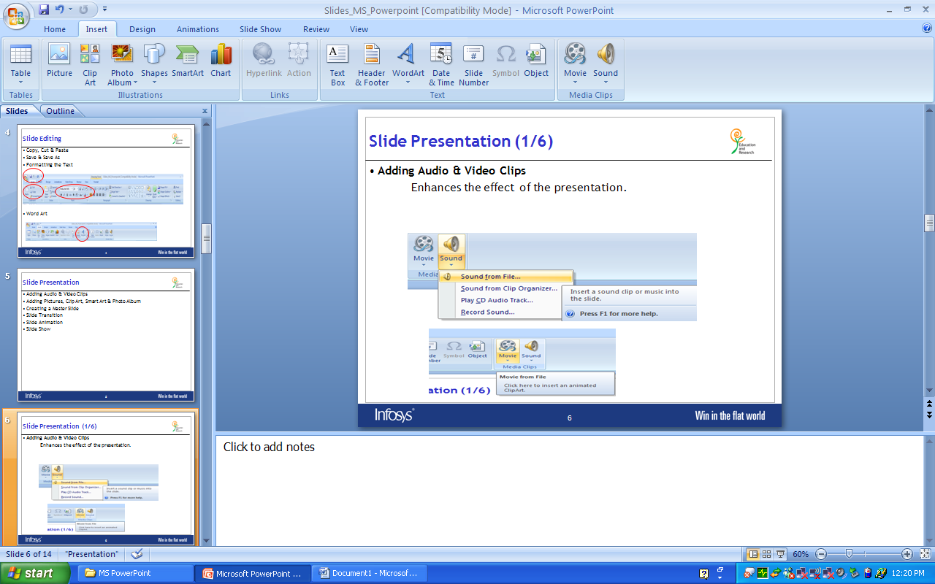
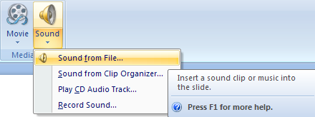
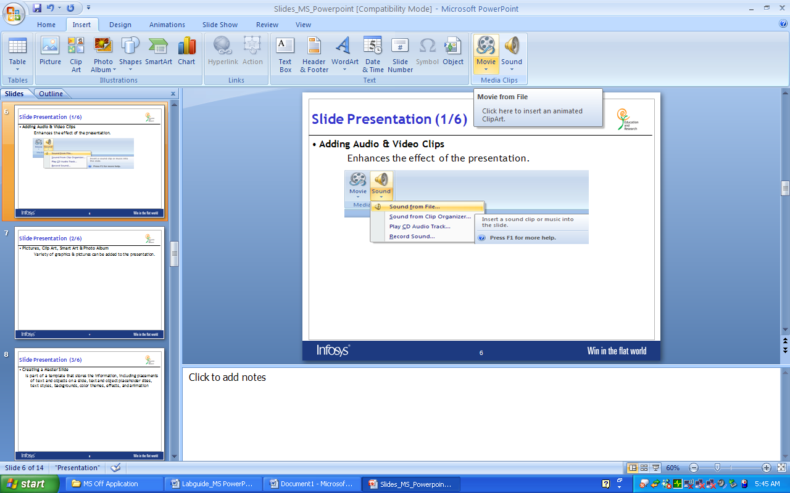
Slide Presentation (1/6)
Adding Audio & Video Clips
Enhances the effect of the presentation.

Slide 7
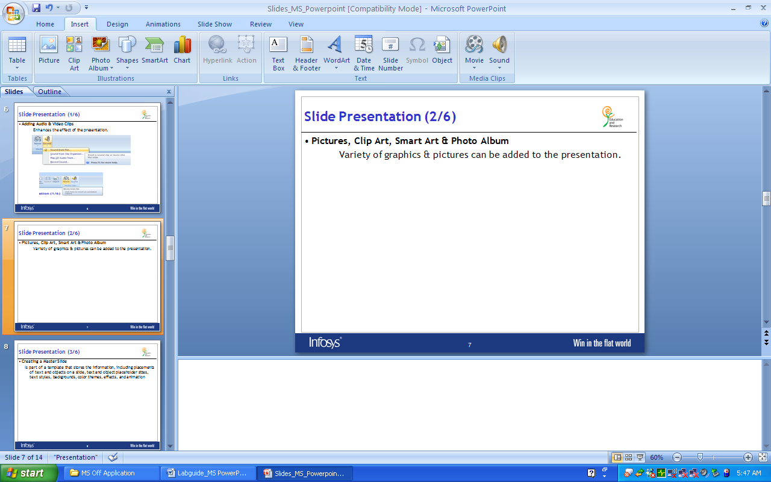
Slide Presentation (2/6)
Pictures, Clip Art, Smart Art & Photo Album
Variety of graphics & pictures can be added to the presentation.

Slide 8
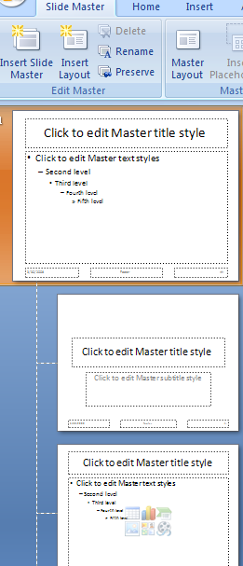
Slide Presentation (3/6)
Creating a Master Slide
  Is part of a template that stores the information, including placements of text and objects on a slide, text and object placeholder sizes, text styles, backgrounds, color themes, effects, and animation

Slide 9
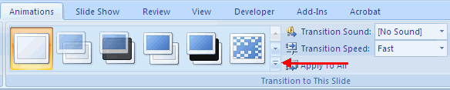
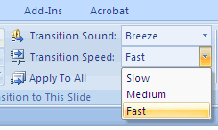
Slide Presentation (4/6)
Slide Transition
  Transitions are effects that are in place when you switch your slide from one to the next.
  Transitions can be,
  with Sounds and Speed
  advance slide by setting the timer

Slide 10
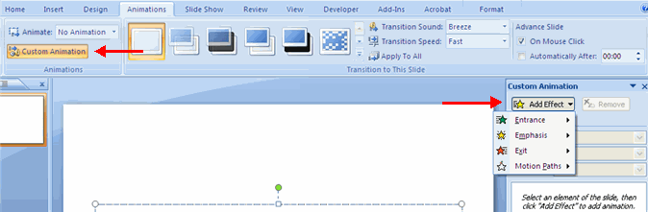
Slide Presentation (5/6)
Slide Animation:
Slide Animation gives special effect to the slides when you view the slides in slide show mode.

Slide 11
Slide Presentation (6/6)
Slide Show
This option allows you to set preferences for how the slide show will be presented
  Record Narration
  Prepare Speaker Notes
Notes:
Slide Show:
The looping options
Narration options
Monitor resolutions

Slide 12
Different PowerPoint Views
Normal View
Slide Sorter
Note Page View
Slide Show View

Slide 13
Print a Presentation
Slides
Handouts
Note Pages
Outline

Slide 14

Thank You

